Slide 1
CHANGING
THE WORLD
ONE SMILE
AT A TIME.

Slide 3
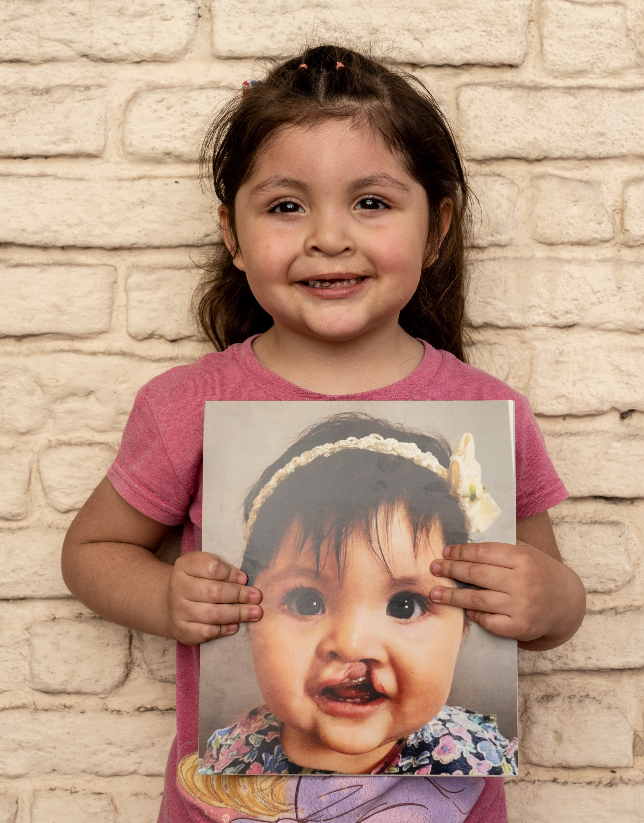
WHAT ARE CLEFTS?
A cleft occurs when certain body parts and structures do not fuse together properly in utero.
Clefts can involve the lip and/or the roof of the mouth, which is made
up of both hard and
soft palate.
1 in 700 babies is born with a cleft lip and/or
palate globally.
Clefts can cause difficulties eating, breathing, hearing,
and speaking.

Slide 4
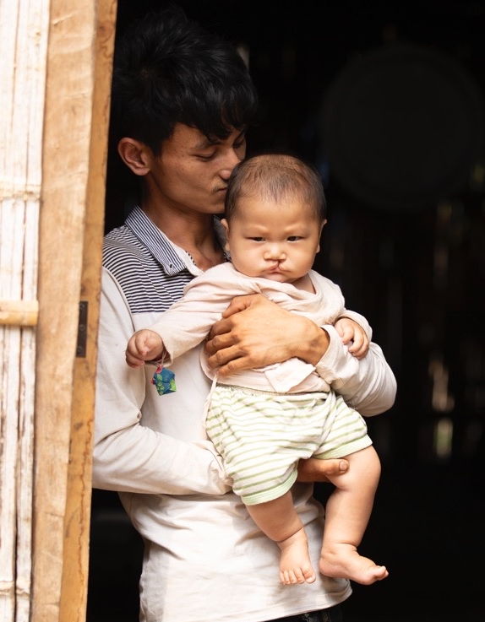
THE PROBLEM
Hundreds of thousands of children in resource-poor communities around the world don’t have access to the lifesaving cleft treatment they desperately need.

Slide 5
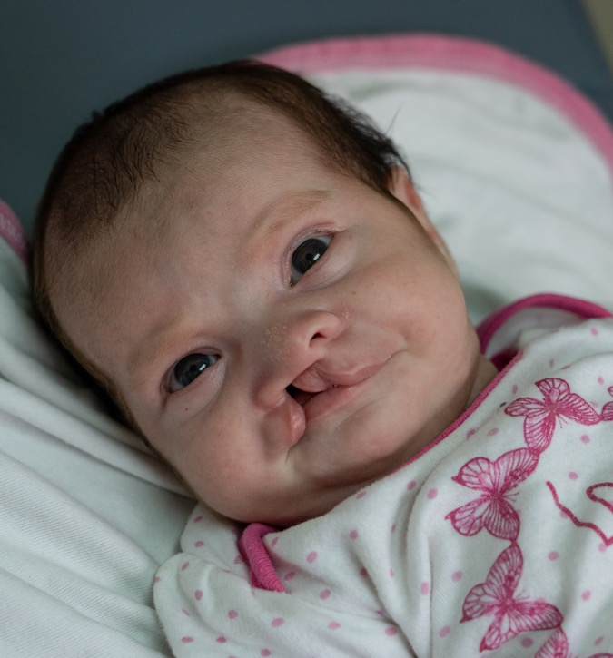
THE PROBLEM
A baby with a cleft is born every 3 minutes.
Without cleft treatment, these babies can experience:
Isolation and prejudice in their communities. No child deserves to feel like an outcast.
Malnourishment due to problems eating. This can result in starvation and even death.
Chronic ear infections. This can result in permanent hearing loss.
Struggles to speak and express themselves. This can result in a lifetime of anxiety and depression.

Slide 6
OUR SOLUTION
We empower medical professionals around the world with the training, funding, and resources they need to provide free cleft surgery and other essential care to children in their own communities.
We advance a sustainable solution and scalable global health model for cleft treatment, drastically improving children’s lives, including their ability to eat, breathe, speak, and, ultimately, thrive.

Slide 7
OUR SUPPORT SERVICES
Smile Train is committed to treating the whole patient through programs that provide access to important comprehensive cleft care services.​ Comprehensive cleft care is intended to ensure long-term, successful rehabilitation for individuals with clefts and includes essential treatments beyond cleft surgery, such as:​​
​
​​
​​
​​
​​
​This comprehensive approach is only possible because our model is focused on empowering local medical professionals and health systems to be available for cleft-affected families every day, all year round.​​

Slide 9
OUR ROLE IN SUPPORTING RESEARCH AND INNOVATION
Smile Train supports research and innovation in low- and middle-income countries (LMICs), with the aim of catalyzing a transformation in how global cleft care research is performed. We identify and foster strategic research opportunities and collaborations through our Global Medical Advisory Board, Research and Innovation Advisory Council, Regional Medical Advisory Councils, and partner network.
Smile Train facilitates global cleft care research through:
Partnership
Funding
Competency building
Networking researchers in LMICs

Slide 10
2000

Slide 11
2014

Slide 12
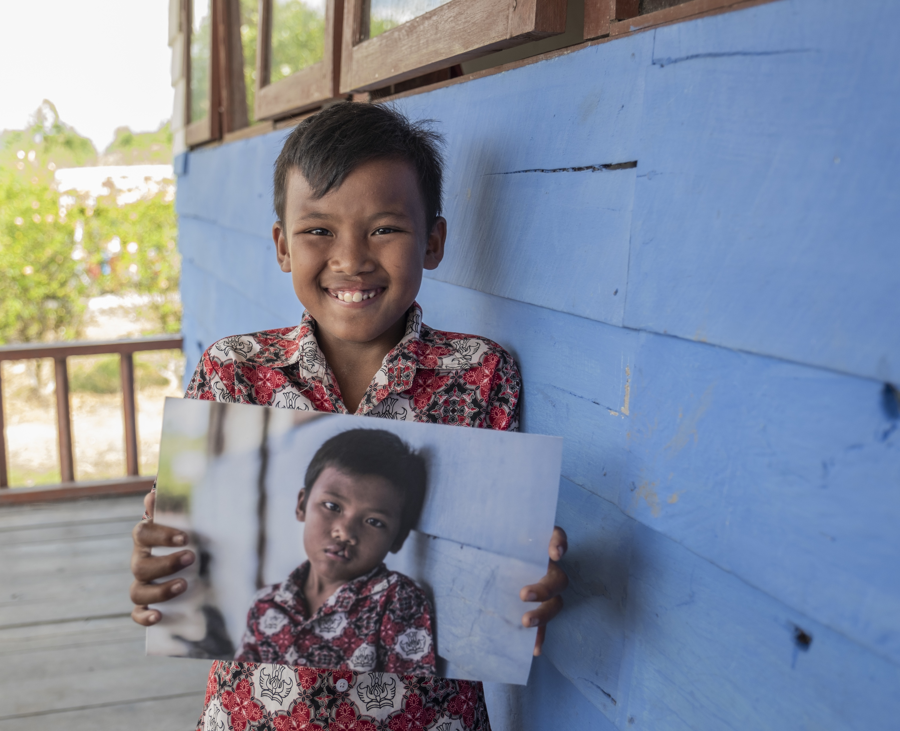
OUR 2 MILLIONTH
PATIENT
Rajib
2024

Slide 13
RAJIB’S STORY

Slide 15
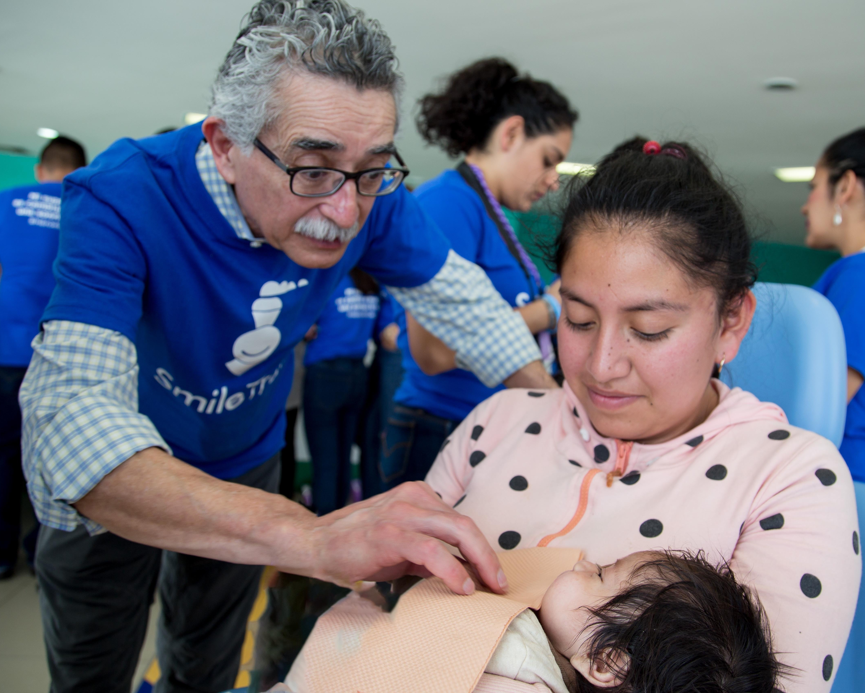
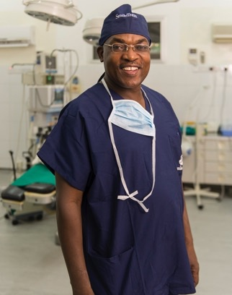
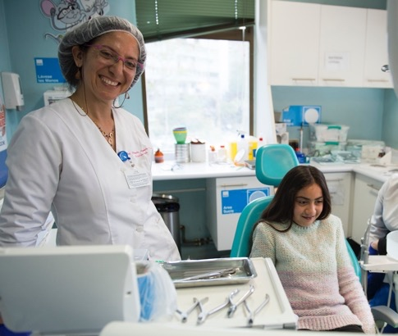
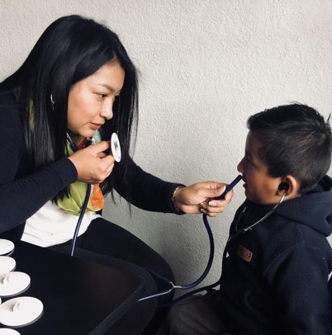
OUR SMILEMAKERS

Slide 16
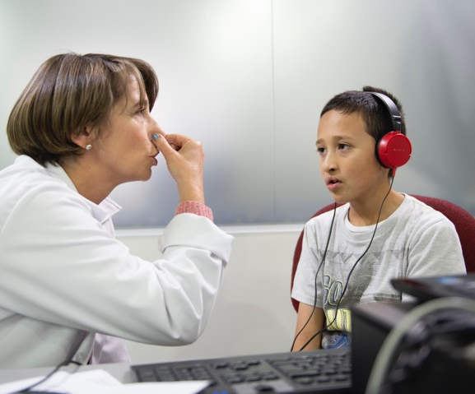
CLEFT TREATMENT CREATES BRIGHTER FUTURES
Children can go to school
Children can learn to eat
Children can learn to speak
Children can become contributing members of their communities

Slide 17
THANK YOU

