Slide 1
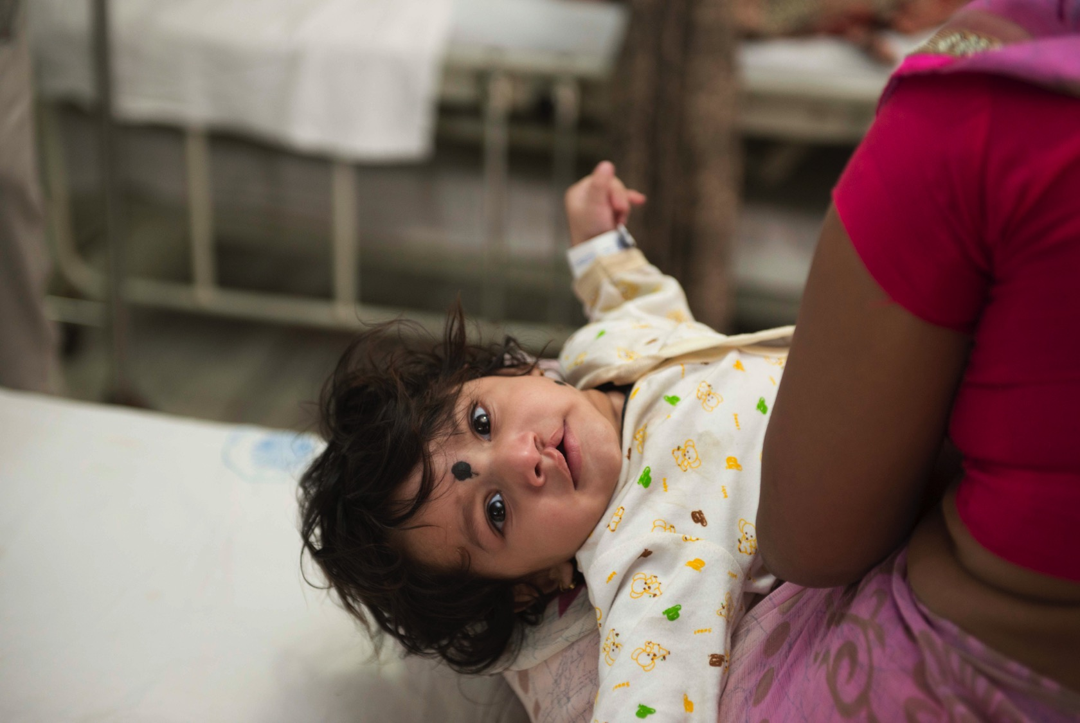
Smile Session #2
Community
Smile Train India
Notes:
This webinar can be shown to students between the ages 8 to 12 directly or can serve as a lesson guide for parents or teachers of younger or older students. There is a supplementary lesson guide packet that can be utilized to bolster this content.

Slide 2
Disclaimer
The information provided in this webinar is meant to be helpful to you and is for informational purposes only. The information contained here should not be relied upon for any specific purpose or used as a substitute for medical advice. While we attempt to thoroughly address specific topics, it is not possible to address every unique situation. Please consult a professional with any questions you might have. Although we attempt to provide accurate and up-to-date information, we make no guarantee to that effect and are not responsible for the content of these resources. All liability with respect to actions taken or not taken based on the contents of the webinar are hereby disclaimed. The content is provided “as is” and no representations are made that the content is error-free.

Slide 3
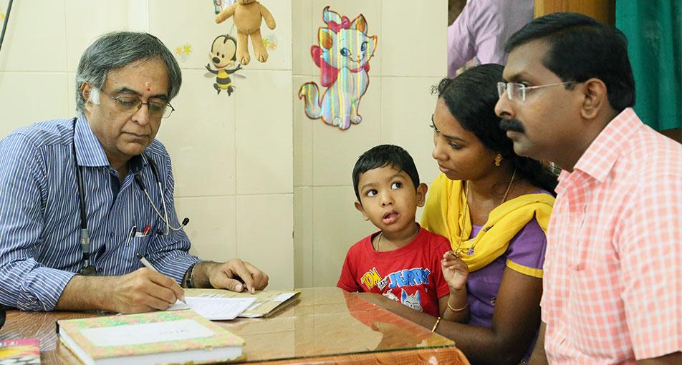
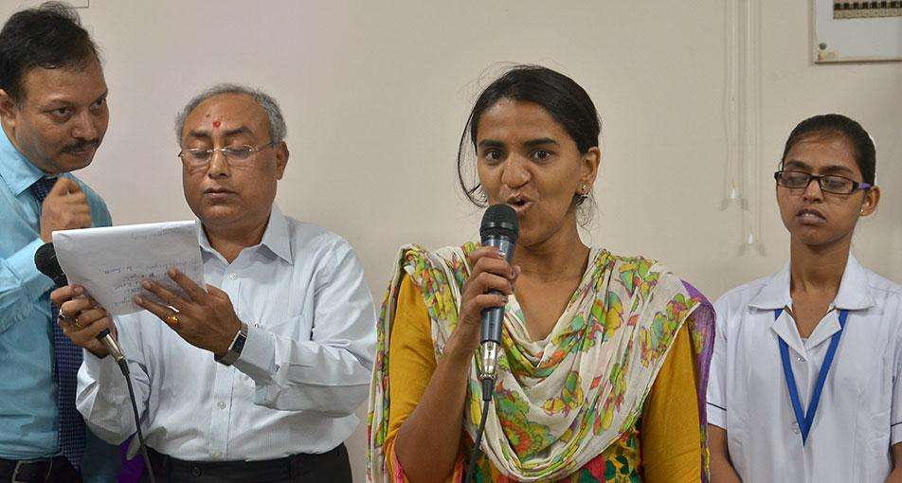
Lesson Objectives
Teach students about community and encourage them to analyze the different connections in their own lives
Create awareness about the interconnectedness of society and how important it is to work together
Show the extensive web of human connections that help Smile Train accomplish its goals
Notes:
The goal of this webinar is to run through a lesson plan that accomplishes the following objectives:
Teach students about community and encourage students to analyze the different connections they have in their lives
Create awareness about the interconnectedness of society and how important it is to work together
Show the extensive web of human connections that help Smile Train accomplish its goals
This lesson is split into three sections; background, making connections, and a fun activity! We will first go through some background information on community and connectivity and how we utilize this at Smile Train to reach as many patients as possible. We will follow that with the making connections section, where we will reinforce information provided in the background section and to teach students about how connectivity is vital to the success of our operations in India. We will tell them Shireen’s story to exemplify how individuals lean on their communities in times of need. We will also show a video on the Smile Torch campaign so that students can see how macro communities are utilized to accomplish major goals. The final section is a fun activity that the students can participate in, today we will be making paper chain necklaces that the students can wear and that will get them thinking about their own communities.

Slide 4
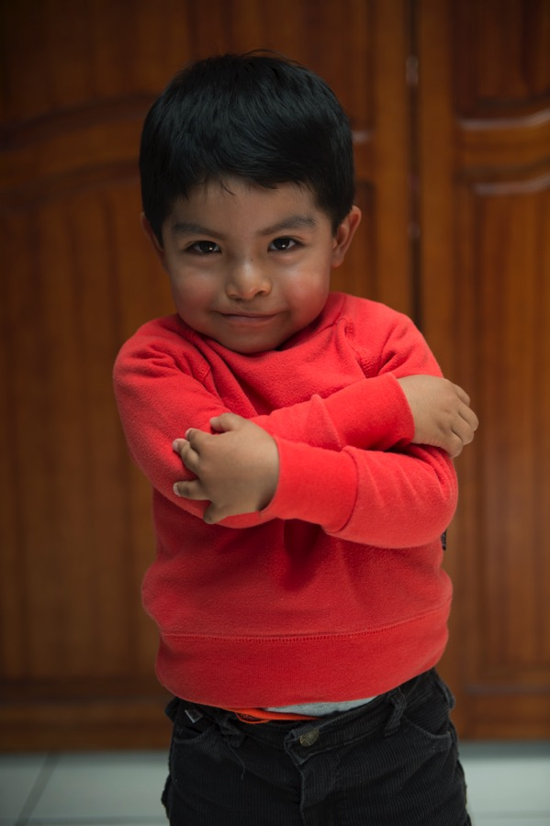
Lesson Information
Background
Making Connections
Activity
Notes:
This lesson is split into three sections; background, making connections, and a fun activity. We will first go through some background information on Community, why it’s important, and how Smile Train relies on community to accomplish our goals. We will follow that with the making connections section, where we will reinforce information provided in the background section show how important it is to work with others and to encourage students to think about the impact of community for Smile Train and in their own lives. In this section we will play a video from one of our incredible staff members, Mamta. She will do a deep dive into our programming in India and talk about the Smile Torch campaign. We will also tell the story of one of our patients in India and how she relied on community to get treatment. Lastly, there are questions for connection for the students to discuss with their peers or anyone else around. Answers are either in the lesson guide packet or derived from student opinions. The final section is a fun activity that the students can participate in! We will be making community chain necklaces.

Slide 5
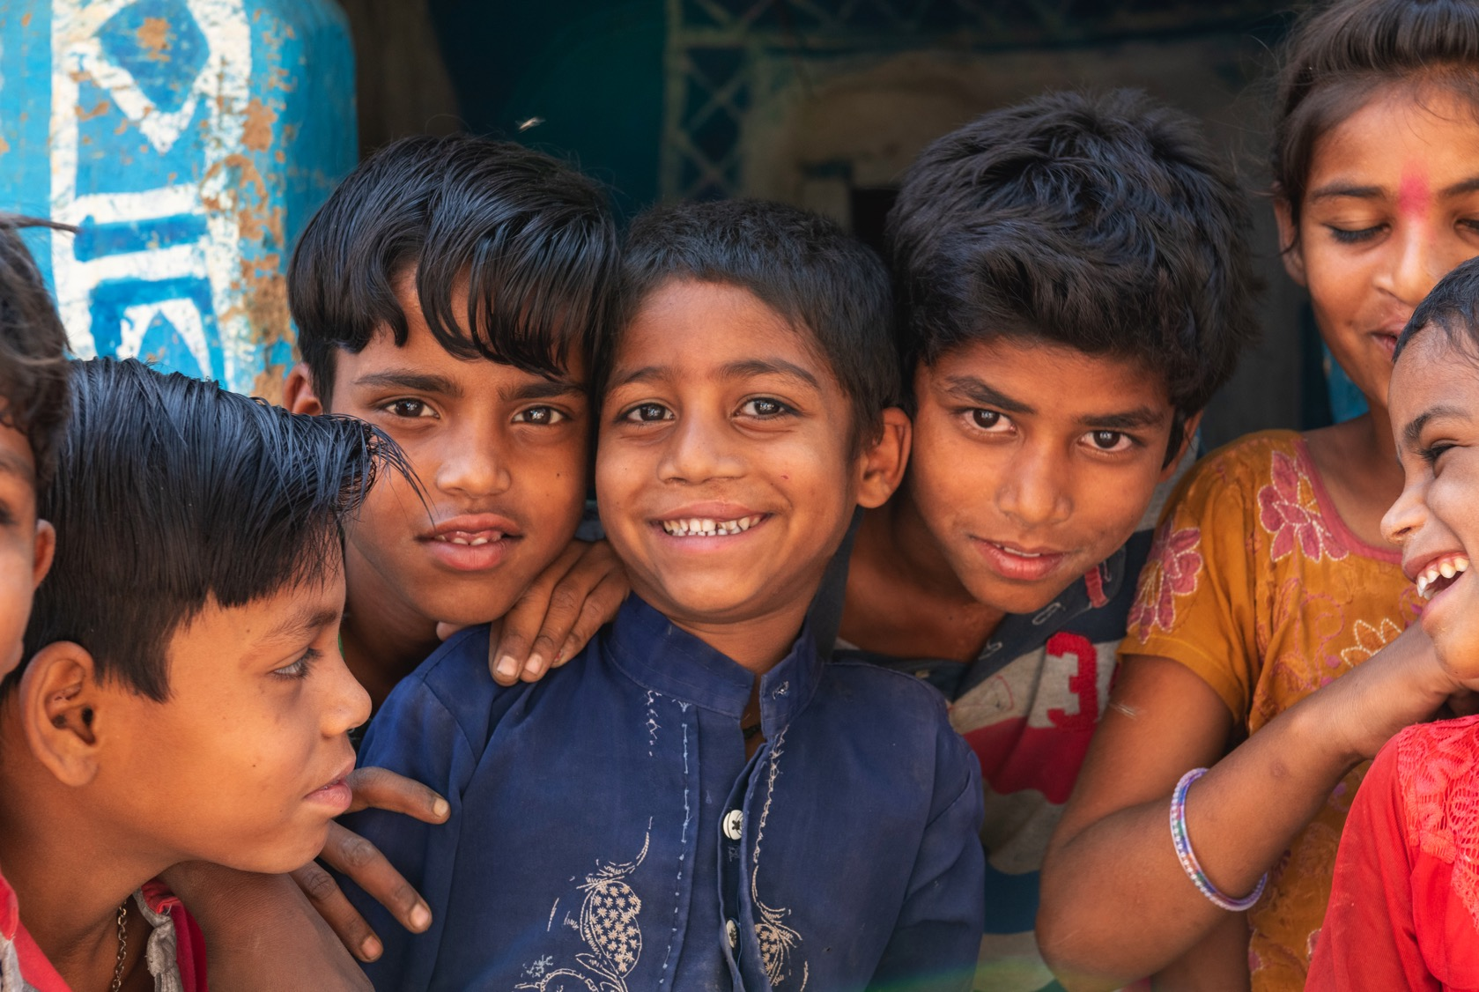
Background

Slide 6
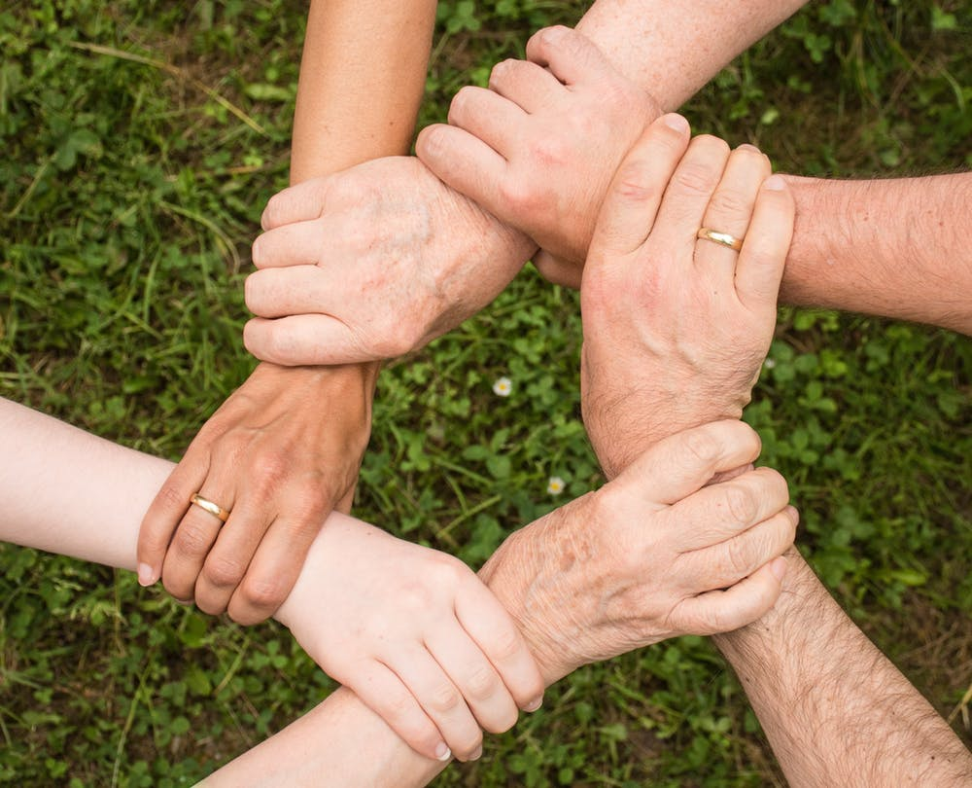
What is community?
Why is it important?
Notes:
Community is about people. A community is a group of people that share something in common whether it is social relationships, location, common interests, or circumstances. Communities meet and form to address communal needs, like solving problems or helping with big projects. Members of a community have a sense of trust, safety, and caring for each other.
Community is important because we can’t do everything on our own and we need to work together. Communities can provide security, support, and opportunity. We can lean on our communities when we need help or want to feel connected.

Slide 7
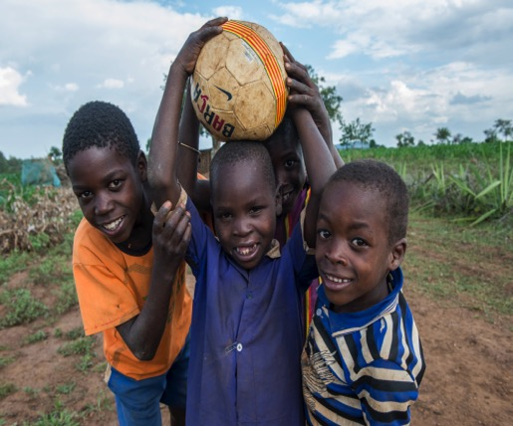
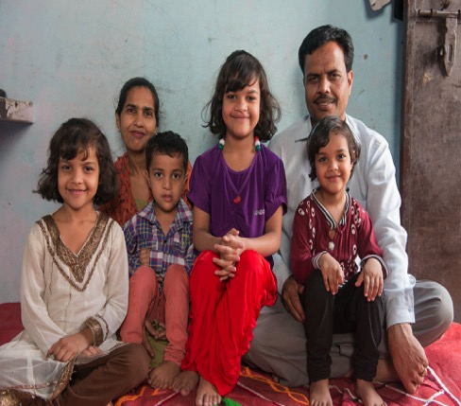
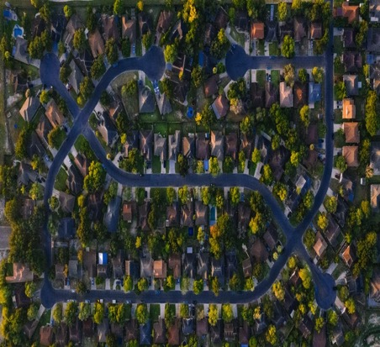
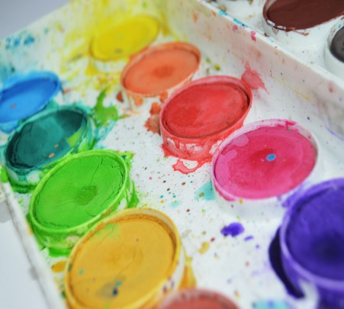
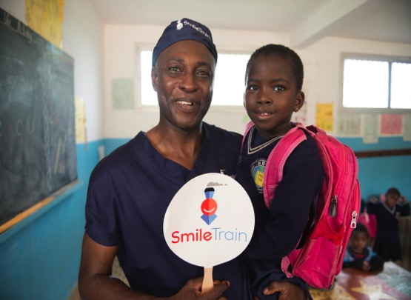
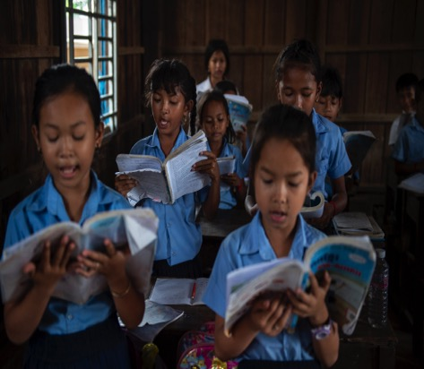
How are we connected?
Location
Family
Socially
Professionally
Education
Interests
Notes:
There are many different types of community. They can be location based, by neighborhood, city, or country. They can be social communities, formed around friendships or recreational activities. Your family is a community. Communities can form around mutual interests, like art or music. There are the communities that form at work or at school.
You are likely a part of more than one community and those communities don’t always exist separately, they can be nested within each other, like a religious community within a neighborhood community or like student groups within a school.

Slide 8
The Smile Train Community
Donors Fundraisers Students Advocates
Headquarters Staff
International Staff
Local Partners
Patients
Families
Notes:
The Smile Train community is comprised of a vast network of individuals who fulfill different roles to help us reach as many child possible. Donors funds/Advocacy committees/student programs – HQ facilitates, they do all sorts of things, I work with students, some do marketing, some work on the logistics side, some work on our programs –international staff, manage programming in their regions and work with governments, other organizations, or our partners – partner hospitals/outreach pros/local marketing/training – patients – family – larger impact
Through our “Teach a Man to Fish” model, we aim to empower local communities to create a sustainable system of care – one that will last and remain productive. We rely on a community of partners to achieve our goals.

Slide 9
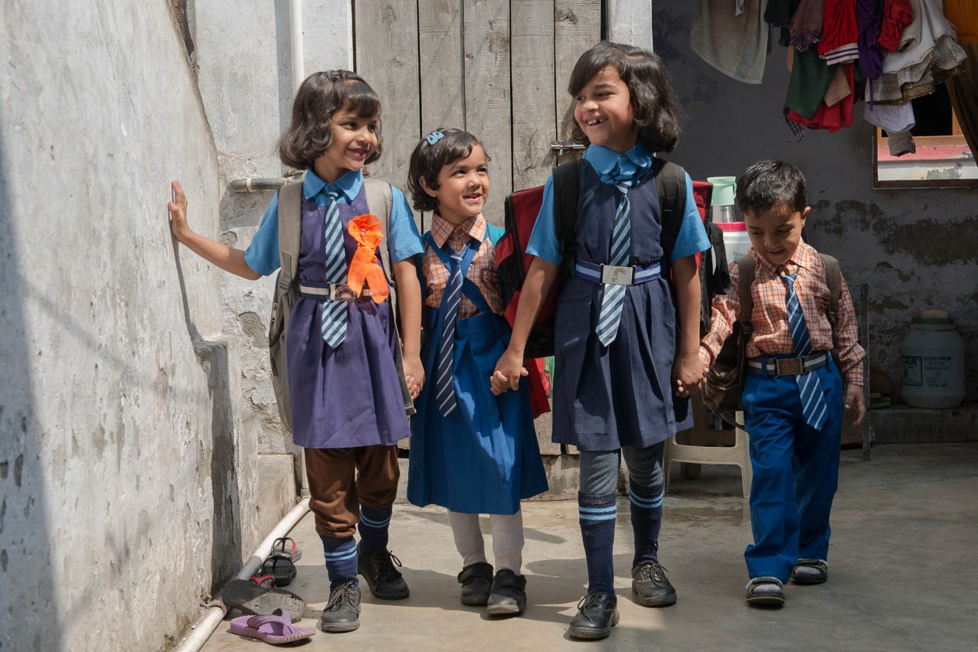
Making Connections
Notes:
This section will provide information on our work in India as well as the Smile Train and local communities that help us carry out our mission. This will include the video of Mamta as well as a Q&A after.

Slide 10
Smile Train India Background
Smile Train India was established in 2000
We currently work with 147 partner hospitals
620,000+ Smile Train-supported cleft treatments​
Notes:
Here are some facts about Smile Train India

Slide 11
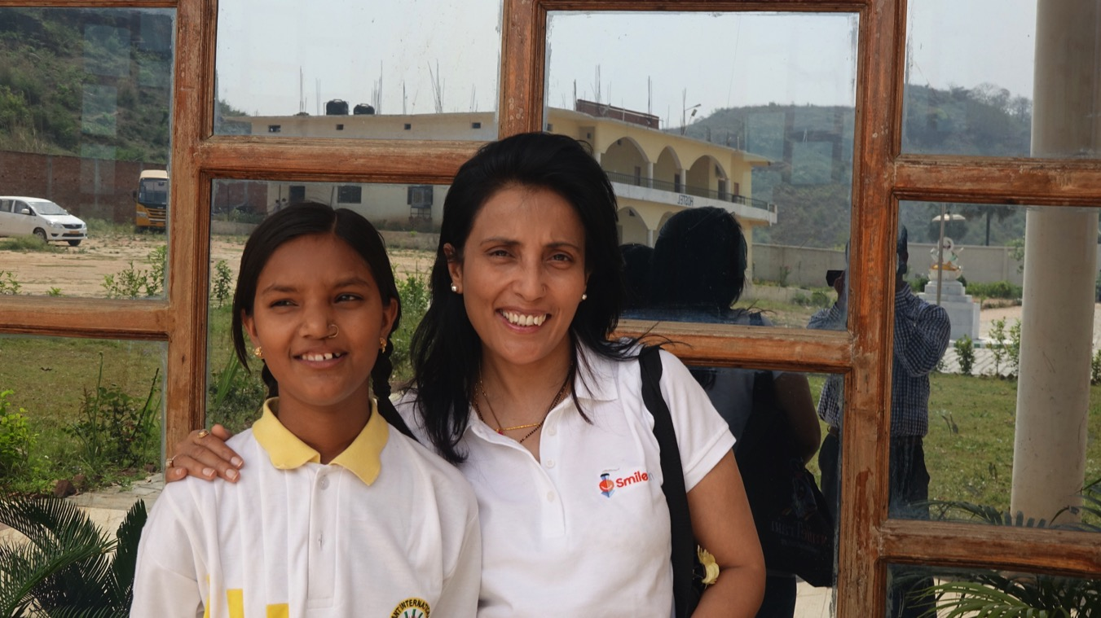
Mamta Video
Notes:
For Mamta's video, click this link: https://youtu.be/-alRyUnLi7s
For more information on the Smile Torch Campaign, check out this video https://youtu.be/891QHgurAdA

Slide 12
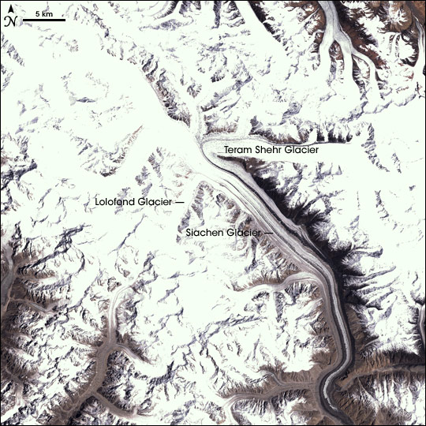
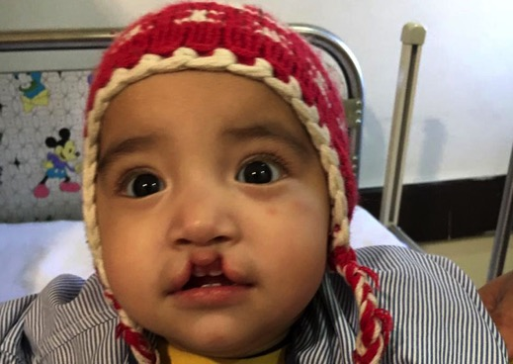
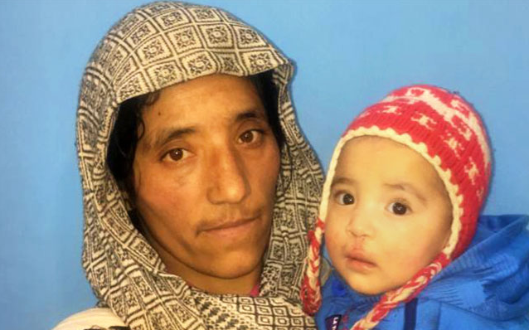
Shireen’s Story
Notes:
https://www.smiletrainindia.org/stories/long-road-smile
Shireen was born with a bilateral cleft lip in the most harsh and mean terrain in India — near the Siachen Glacier. It is so cold there that even the thought of the sub-zero temperatures is enough to give most people a shiver down their spines.
Though their village was remote, this did not stop her grandfather from seeking treatment for Shireen. Shireen’s family walked twenty kilometers on a frozen lake to catch a bus to reach the nearest city to their village. In that city they waited for their turn to catch a flight run by the Indian Air Force to the capital, for flights like these, the wait time can stretch to weeks or sometimes even months.
After all this travel, Shireen finally reached the hospital in the big city! After learning about their long journey, Smile Train partners worked hard to make sure the trip was not in vain. They had a window of only one week, as Shireen’s flight home was to leave then -- had they missed it, they would not be able to return home for a whole month! This story has a happy ending, Shireen was able to get her surgery and fly home with her family.

Slide 13
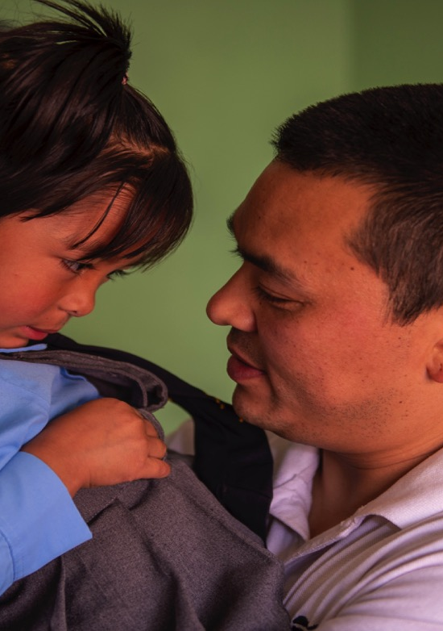
Questions for Connection
Why are communities important?
How do we grow our network of connections?
What are some of your communities?
How does community help Smile Train to reach patients?
What are some ways that families utilize connections in their communities?
Besides surgeons and doctors, who are other partners that help Smile Train?

Slide 14
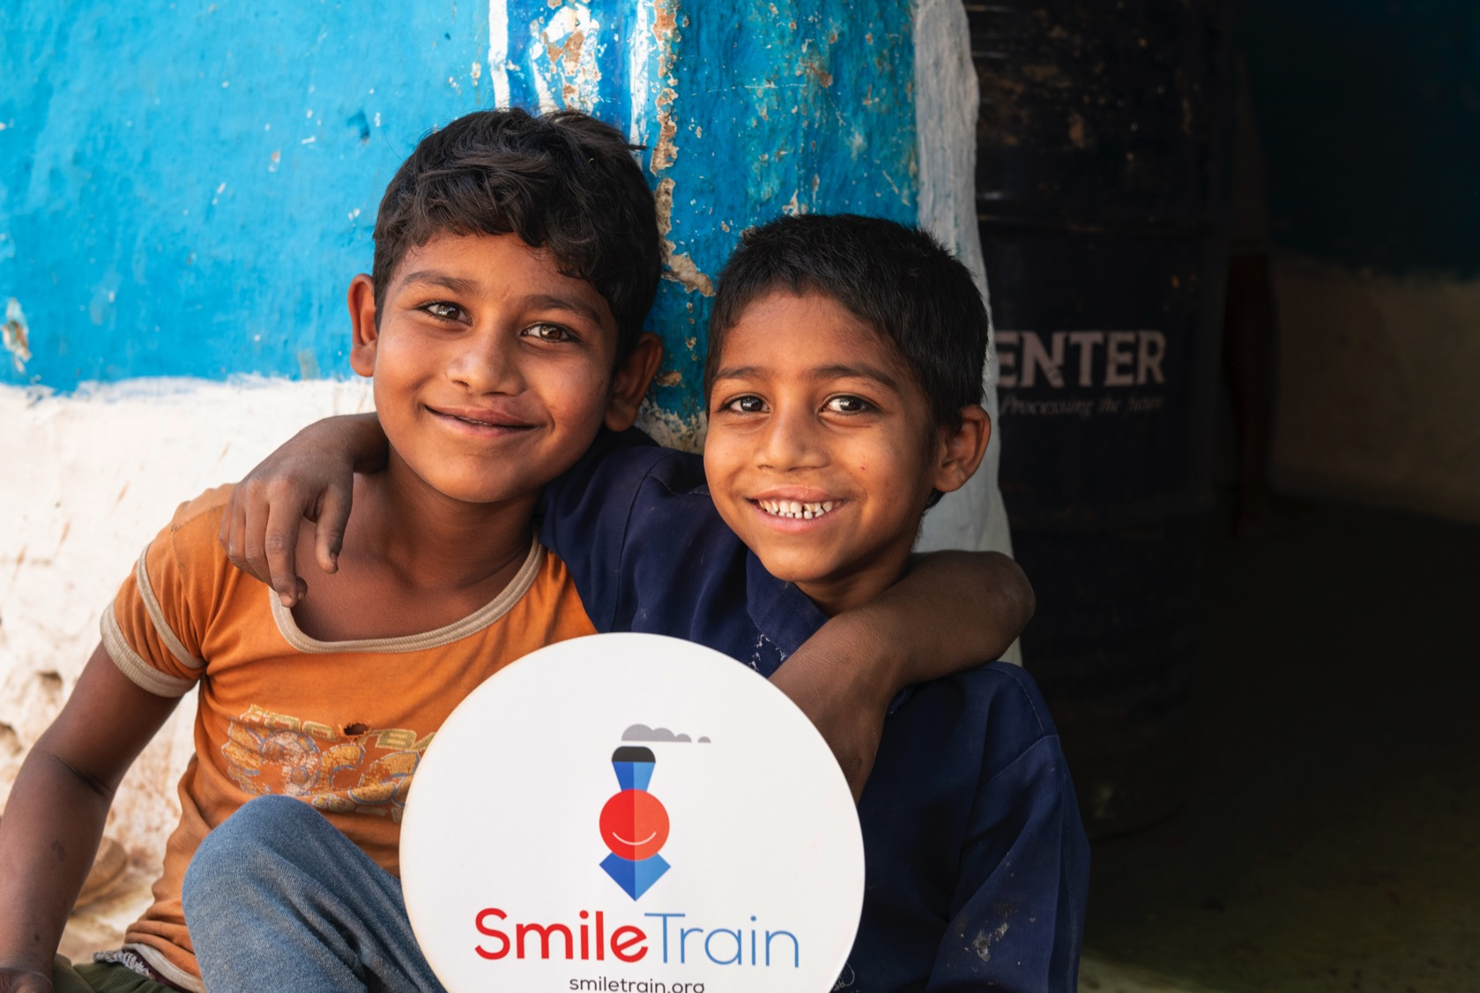
Connection Activity

Slide 15
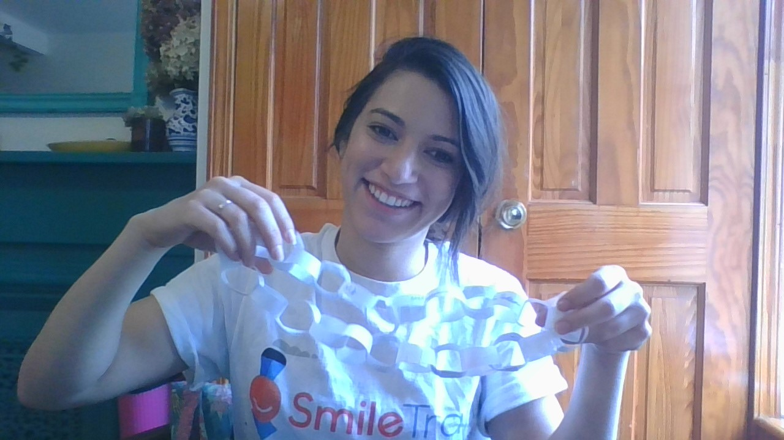
Paper Chain Necklace
Notes:
Catch the video here:
https://youtu.be/WzdcRRmcdXk

Slide 16
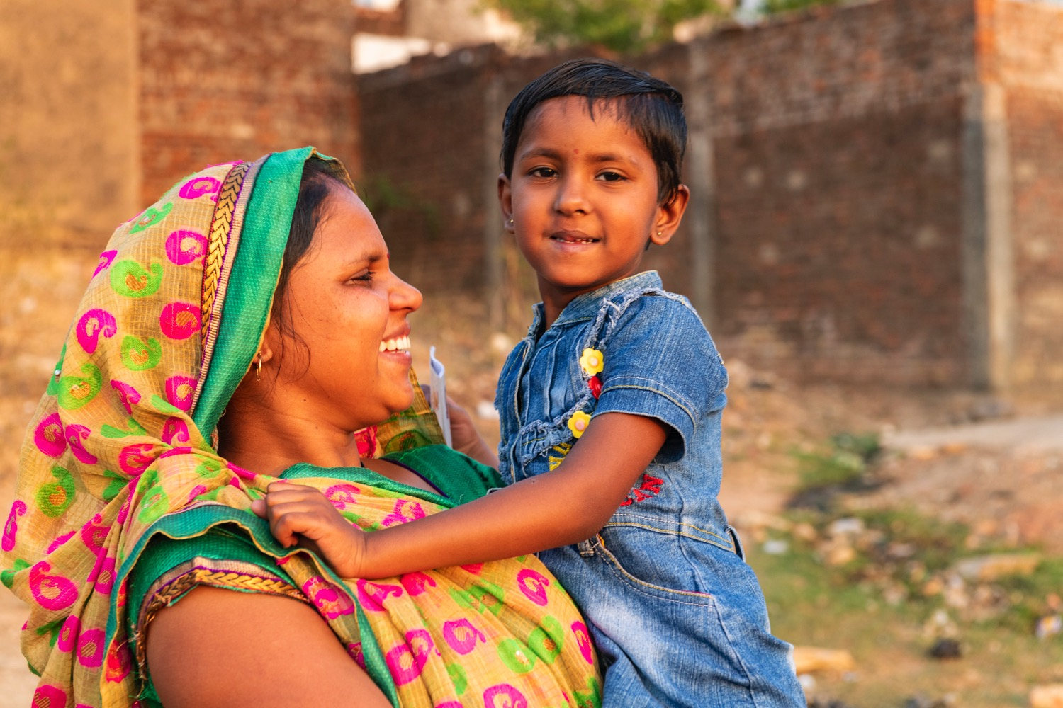
smiletrain.org
@Smiletrain
Thank You

Slide 17
Sources
Allen, Jesse. Earth Observatory; University of Maryland's Global Land Cover Facility - http://earthobservatory.nasa.gov/Newsroom/NewImages/images.php3?img_id=17253, Public Domain, https://commons.wikimedia.org/w/index.php?curid=733483
Chavis, David M. & Kien Lee. “What is Community Anyway?” Stanford Social Innovation Review. (2015). https://ssir.org/articles/entry/what_is_community_anyway
Smile Train. Main Website. https://www.SmileTrain.org
Smile Train India. Stories. https://www.smiletrainindia.org/stories

