Slide 2
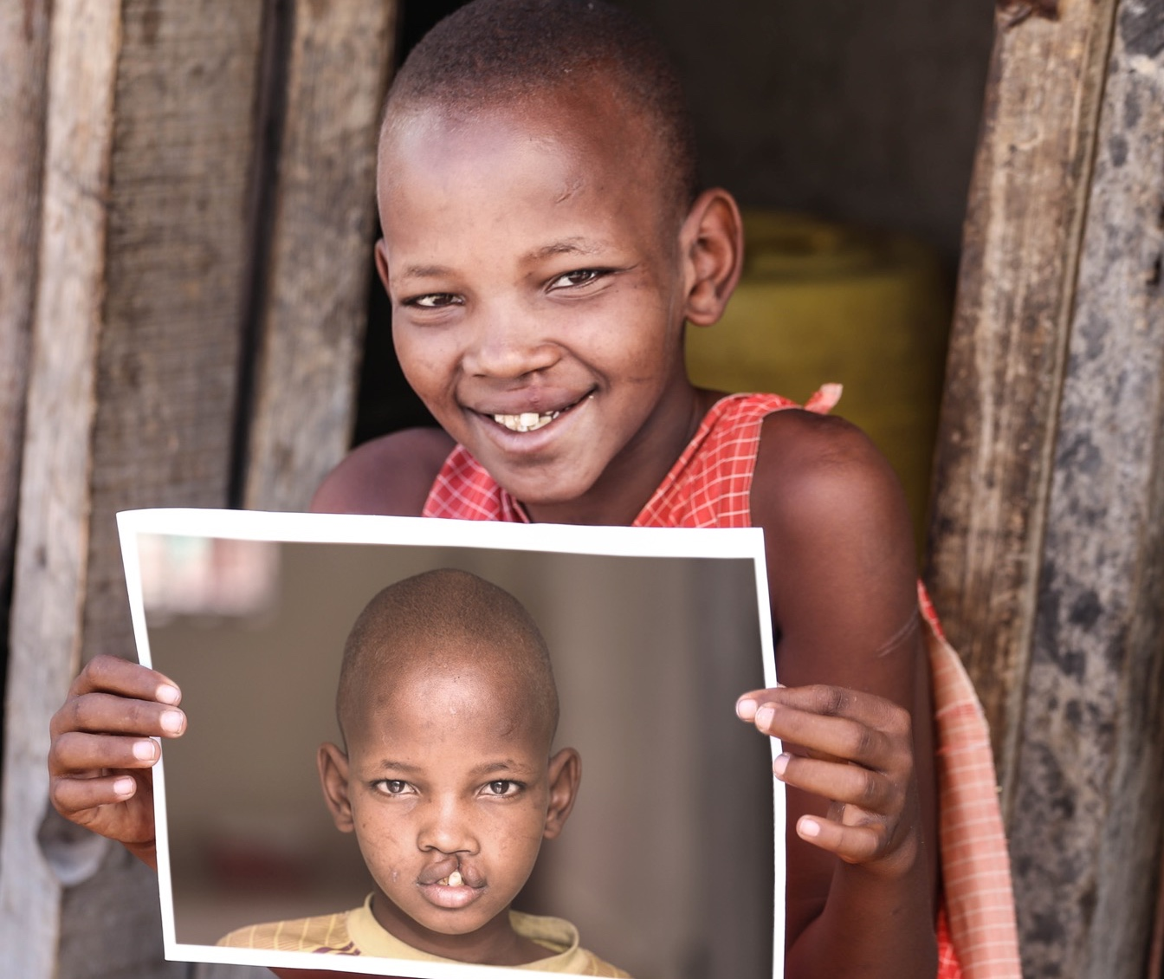
Vision
Smile Train’s vision is a world where every person has access to high-quality comprehensive cleft care and is able to live a full and healthy life.

Slide 3
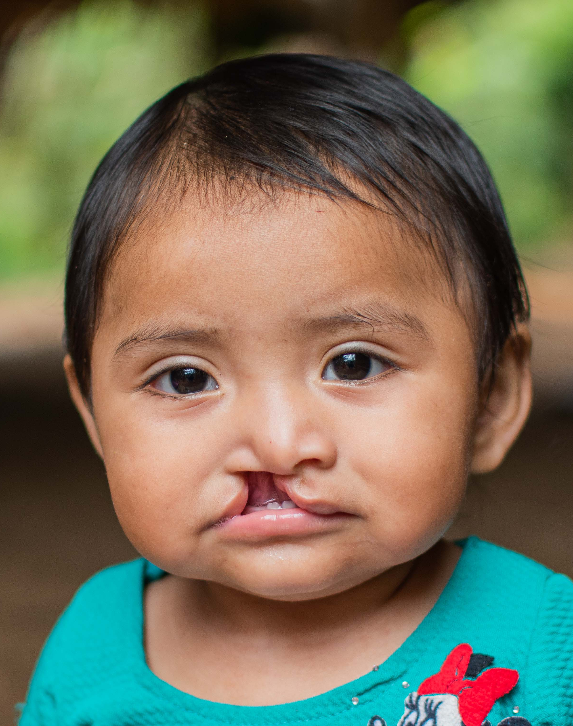
What is Cleft?
A cleft occurs when certain body parts and structures do not fuse together properly during fetal development.
Clefts can involve the lip and/or the roof of the mouth, which is made up of both hard and soft palate.
1 in 700 babies are born with a cleft lip and/or palate globally.
Clefts cause difficulties eating, breathing, hearing, and speaking.

Slide 4
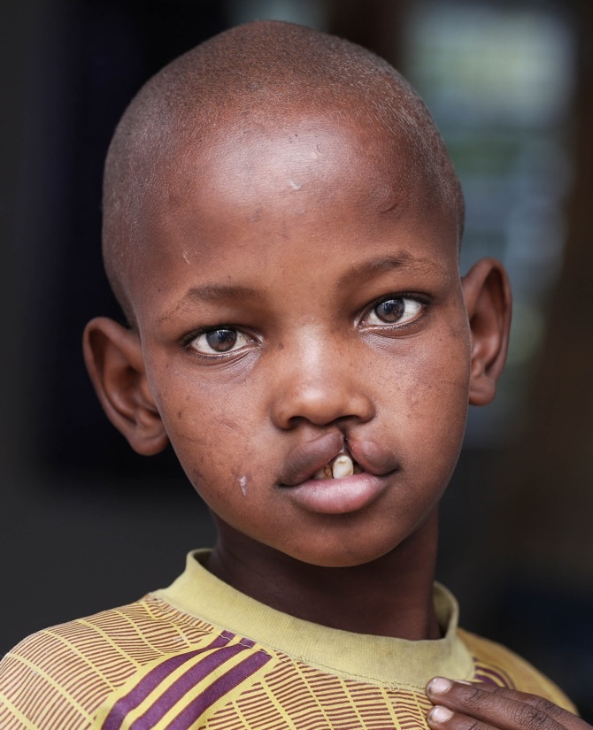
What Causes Cleft?
No one knows exactly, but most experts agree that the causes of cleft may include a genetic predisposition and environmental exposures.
As a cleft is one of the most common birth differences, it is important to note that an expectant mother can avoid all of the potential risk factors and still have a baby with a cleft.
In most cases, it is difficult to determine what caused a cleft, but research is ongoing to better understand the condition.

Slide 5
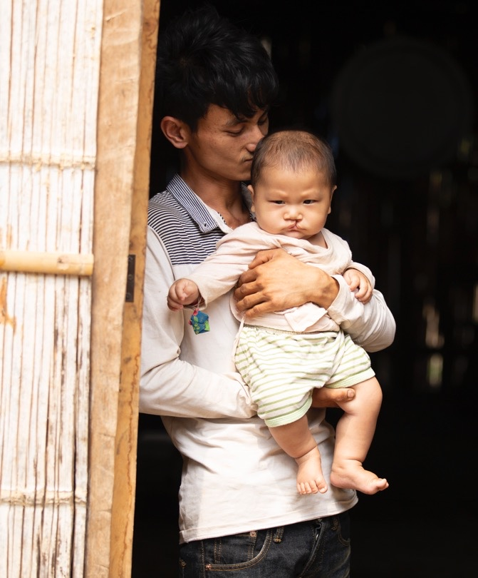
The Problem
Hundreds of thousands of children in resource poor communities around the world don’t have access to the lifesaving cleft treatment they desperately need.

Slide 6
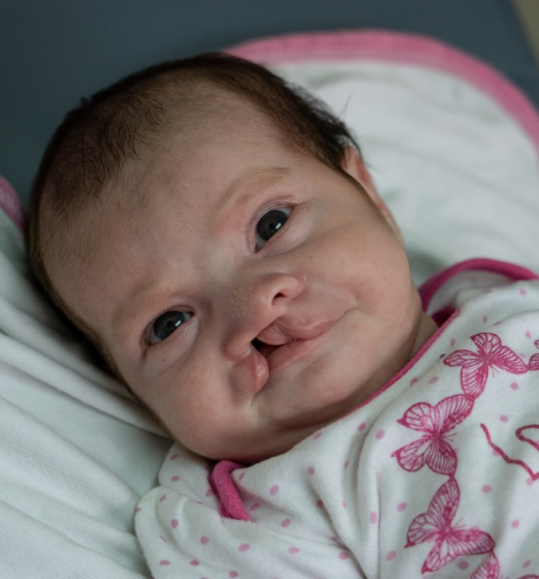
The Problem
A baby with a cleft is born every 3 minutes.
Without cleft treatment these babies can experience:
Isolation and often face prejudice in their communities. No child deserves to feel like an outcast.
Becoming malnourished due to problems eating. This can result in starvation, and even death.
Chronic ear infections. This can result in permanent hearing loss.
Struggling to speak and express themselves. This can result in a lifetime of anxiety and depression.

Slide 7
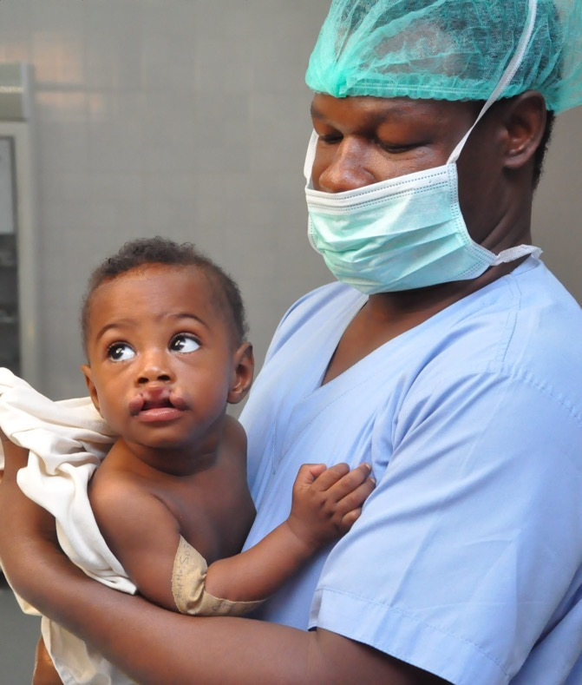
The Solution
Smile Train empowers local medical professionals with training, funding, and resources to provide free cleft surgery and essential care to children globally.
Smile Train advances a sustainable solution and scalable global health model for cleft treatment, drastically improving children’s lives, including their ability to eat, breathe, speak, and ultimately thrive.

Slide 8
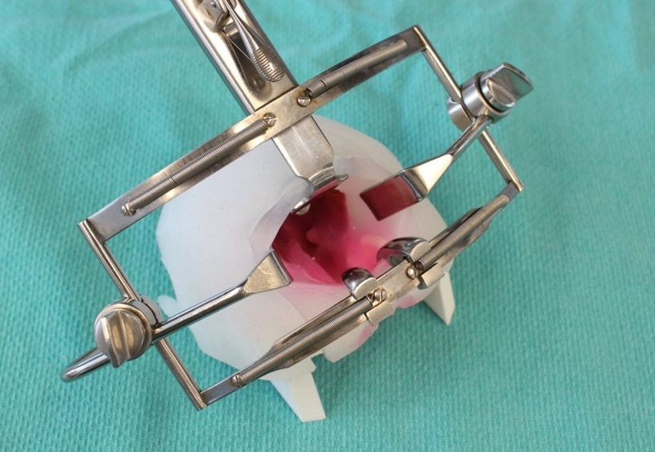
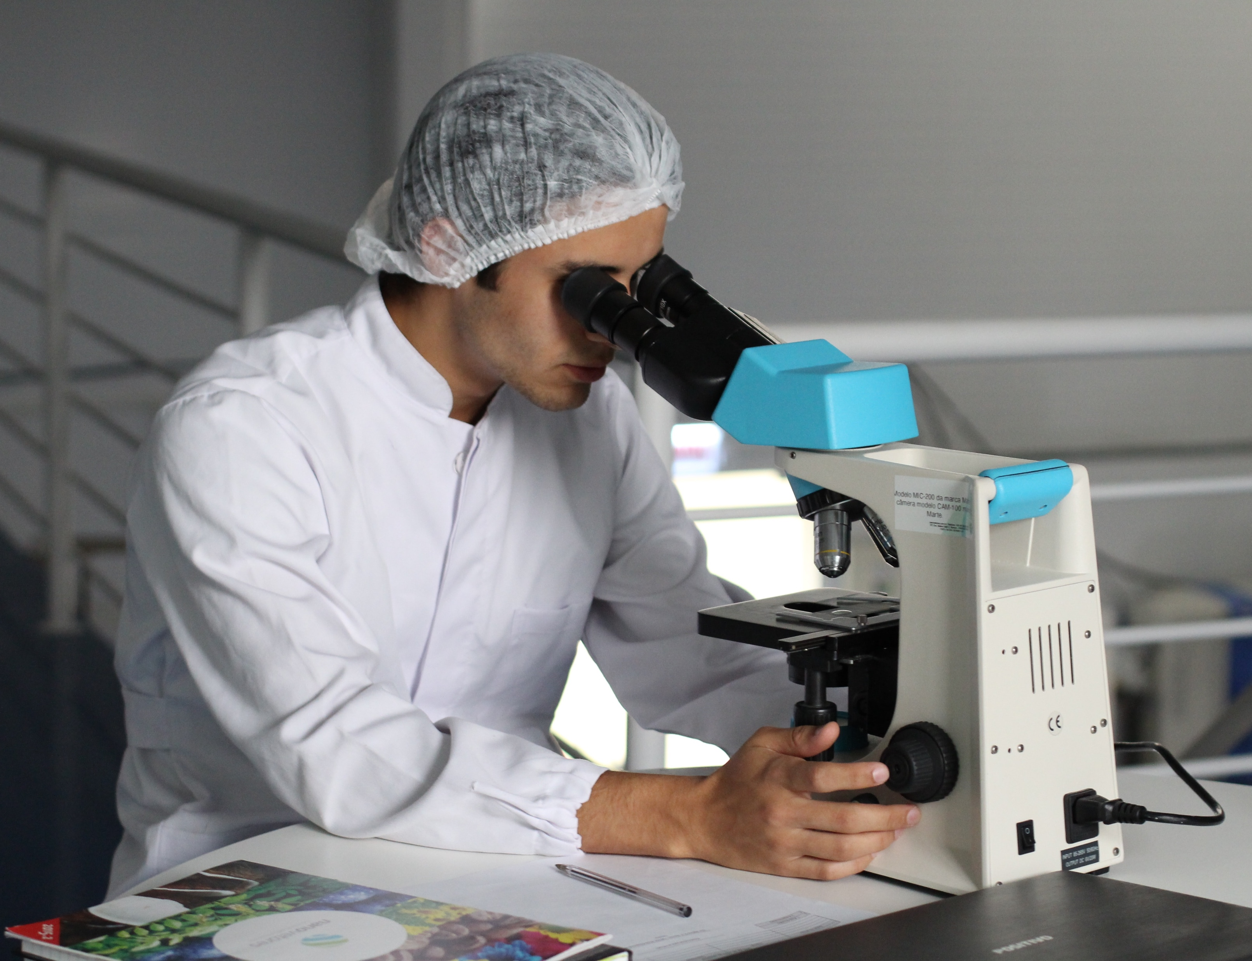
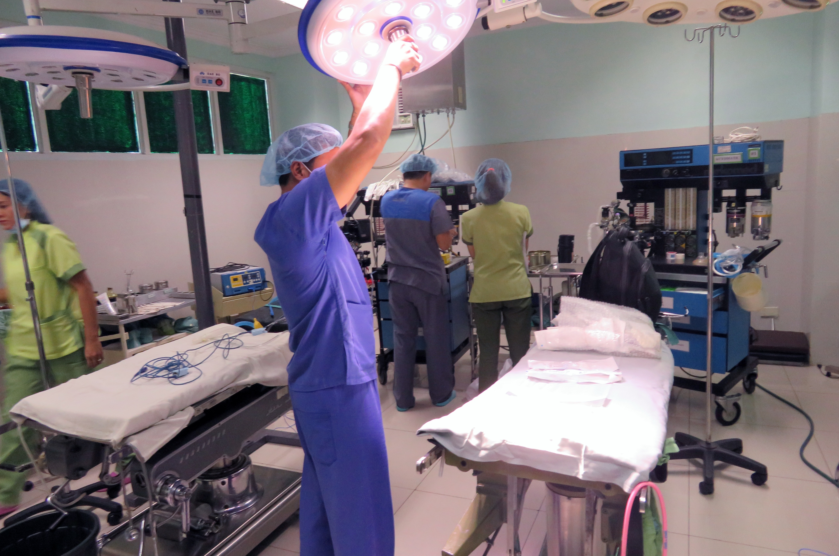
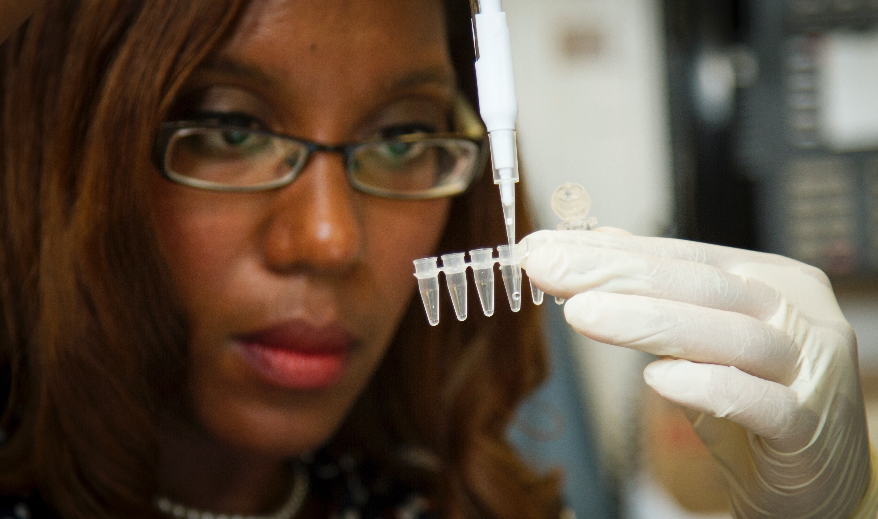
Smile Train aims to pursue bold ideas, leverage data and technology to undertake, support and enable research and innovation.

Slide 9

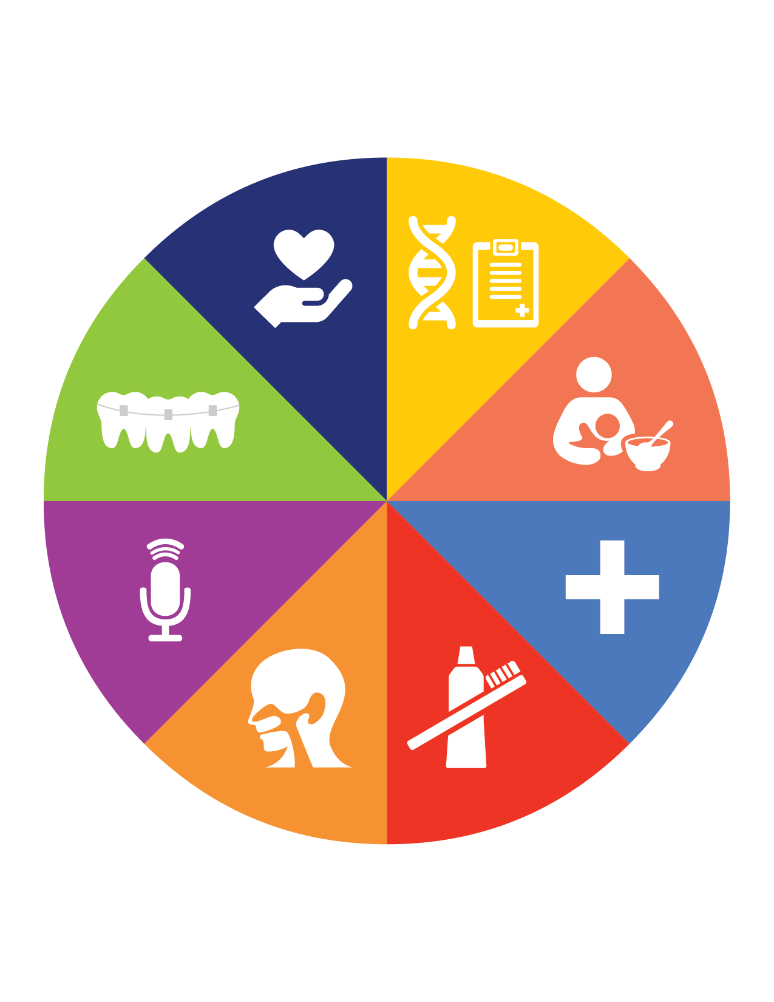
Our Comprehensive Approach
Smile Train is committed to treating the whole patient through programs that provide access to important comprehensive cleft care services.
Comprehensive cleft care is intended to ensure long-term, successful rehabilitation for cleft patients and includes essential treatments beyond cleft surgery, such as:
This comprehensive approach is only possible because our model is focused on empowering local medical professionals and health systems to be available for families affected by cleft every day, all year round.

Slide 10
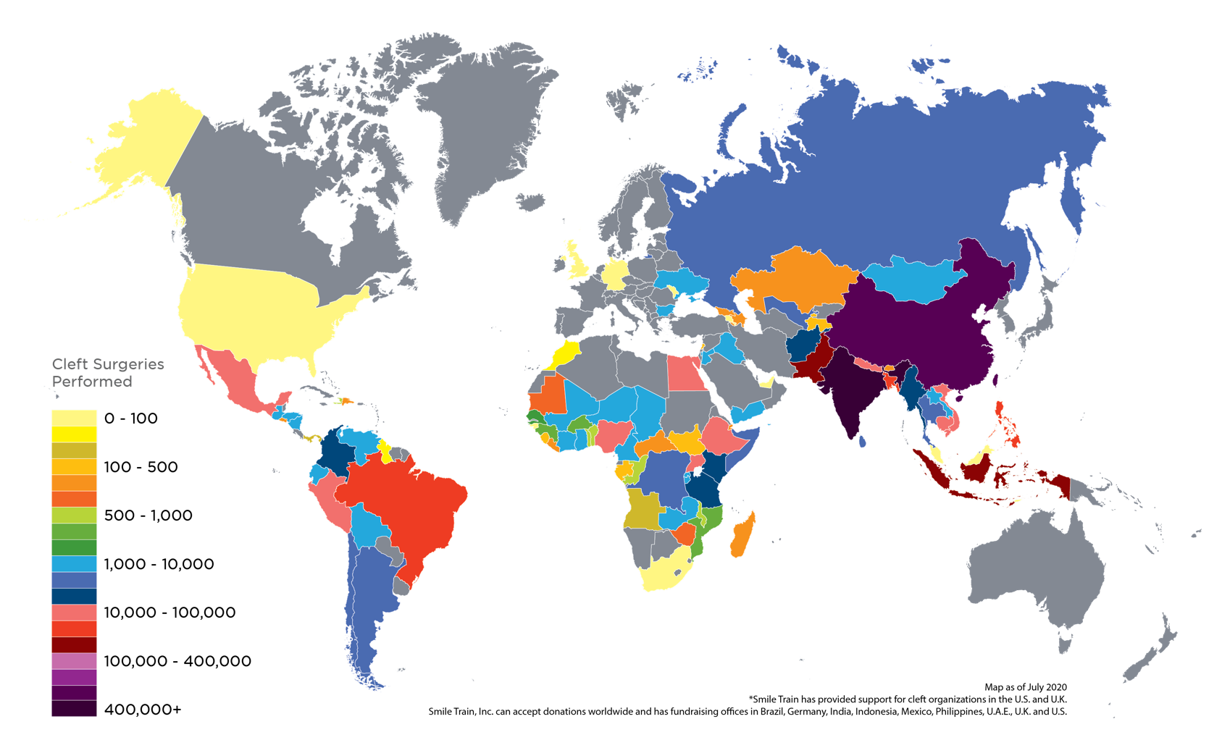
Showing the World the True Power of a Smile Around the Globe

Slide 11
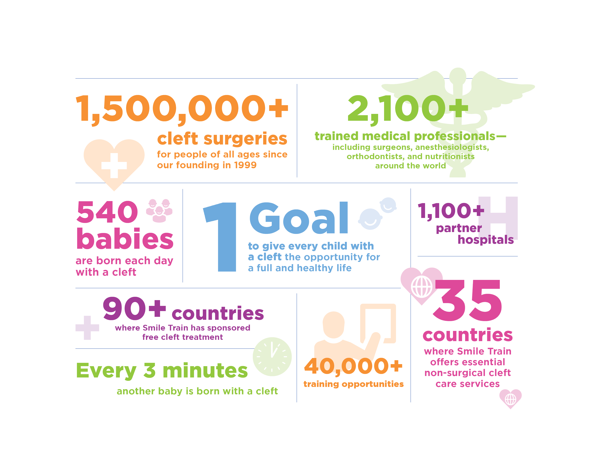
Our Impact

Slide 12
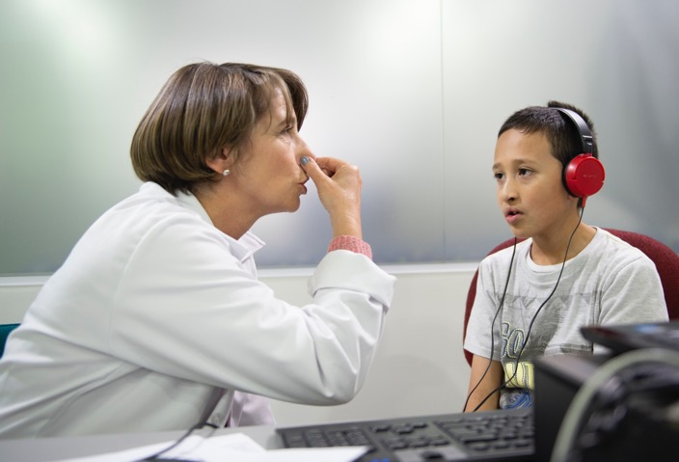

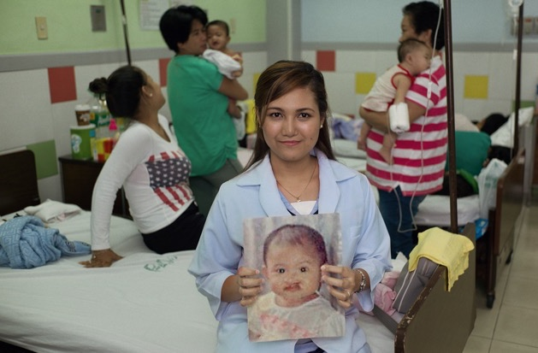

Cleft Treatment Creates
Brighter Futures
Children can go to school
Children can learn to eat
Children can learn to speak
Children can become contributing members of their communities

Slide 13
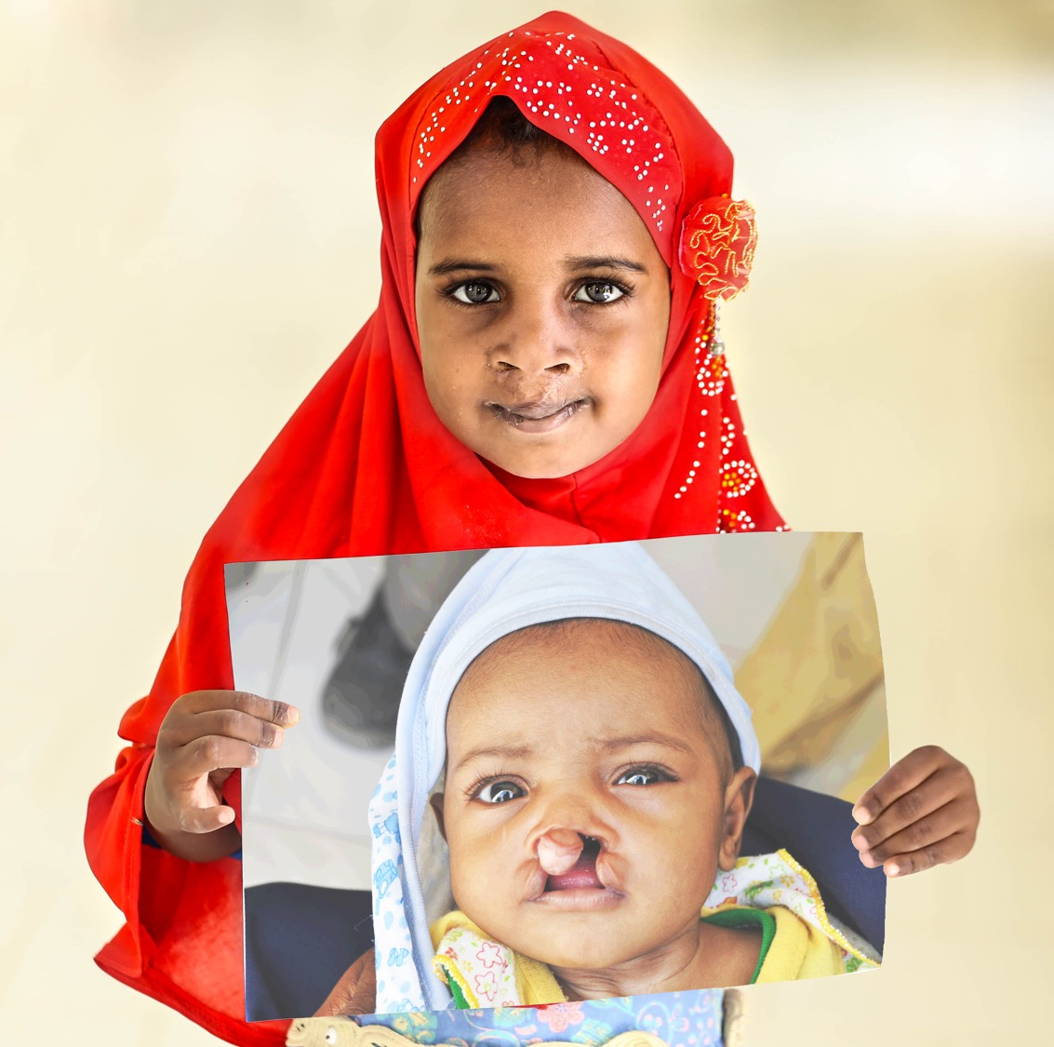

Thank You

